Slide 1


June 13, 2017
Kelly Delforge, Director, HR Strategy
Division of Human Resources
Jan Myers, Compensation Consultant
Division of Human Resources

Slide 2


PROJECT OBJECTIVES
Agenda
Compensation
Philosophy
Job
Function
Head
Head
The University Career Architecture Project will:
Create a career and compensation infrastructure for classified staff and appointed professionals
Provide the University and managers with relevant market data to make quicker and more informed employment decisions
Notes:
Kelly

Slide 3
KEY DELIVERABLE
Appointed Professionals
Classified Staff
Job Functions and Families
Notes:
Kelly

Slide 4




CLASSIFIED STAFF AND APPOINTED PROFESSIONALS IN SCOPE
9867
Notes:
Kelly

Slide 5
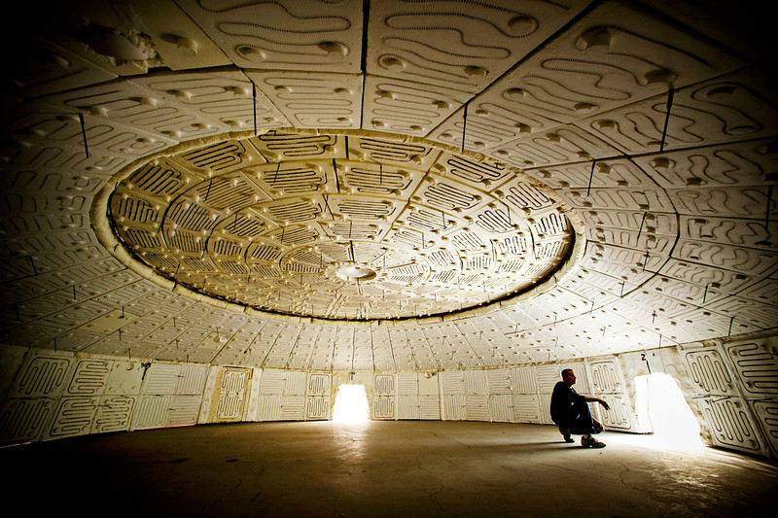
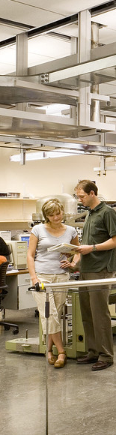
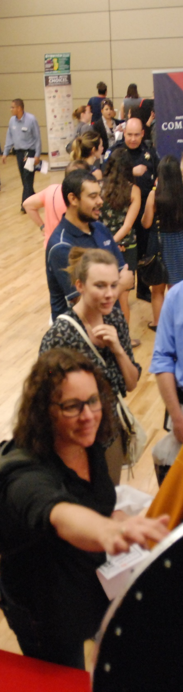


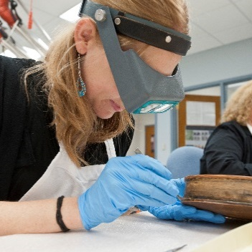
Number of unique job titles currently
2716
Number of single incumbent titles currently
2003
Notes:
Kelly

Slide 6

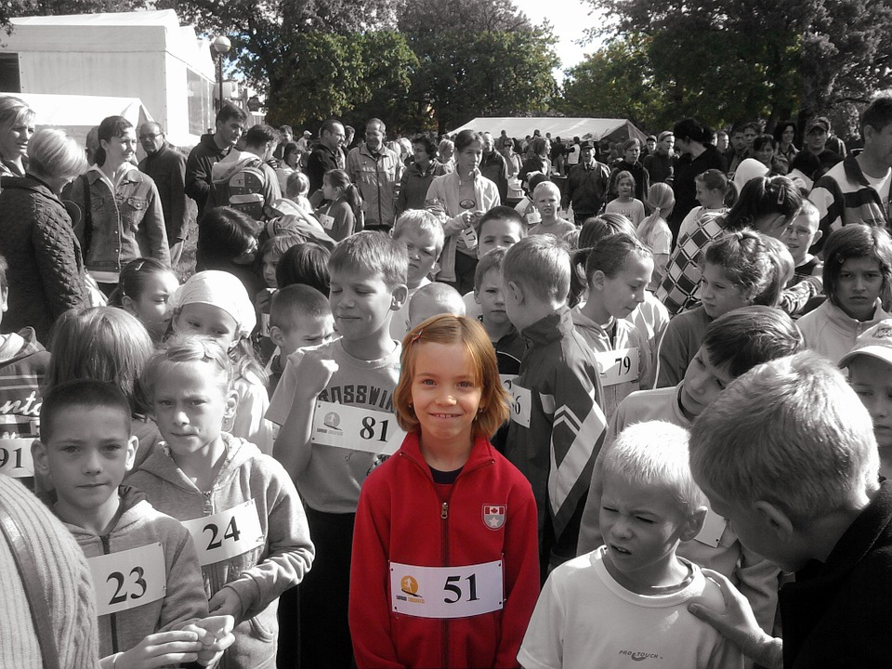

HOW DID WE GET HERE?
Notes:
Kelly

Slide 7
WHERE DO WE WANT TO GO?
Functions are broad categories of job families that can be logically grouped together based on having similar characteristics or prerequisite skills
Families are unique occupations that can be performed at various levels: support, professional/individual contributor and managerial
Job Function | Job Families
Information Technology | Applications Development Desktop Support Network Engineering Systems Administration Telecommunications Web Development
Notes:
Jan

Slide 8
FACULTY HAVE A CAREER LADDER
Postdoctoral Scholar
Assistant Professor
Associate Professor
Professor
Notes:
Jan

Slide 9
OTHERS WANT LADDERS TOO
Accounting Specialist
Accountant
Senior Accountant
Lead Accountant
EXAMPLE
Notes:
Jan

Slide 10


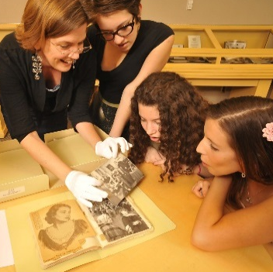
FACTORS
THAT
DEFINE
LEVELS
Operational Latitude
Knowledge
Interpersonal Contacts
Complexity of Work
Impact of Actions and Decisions
Managerial Span
Required Education
Required Experience
Notes:
Jan

Slide 11
SAMPLE CAREER LADDER DISTINCTION (Complexity of Work)
 | Entry Level | Intermediate Level | Senior Level
Complexity of work | Solves routine problems and works on projects with limited scope following established policies and procedures. | Develops solutions to a wide variety of problems and works on projects of moderate complexity. Refers to policies and practices for guidance but determines best course of action to achieve results. | Develops solutions to complex problems where analysis of situations or data require in-depth evaluation of variables and options.
Notes:
Jan

Slide 12
EXCITEMENT VS. CONCERN
Our community WANTS:
Our community FEARS:
Reliable and readily available data to make decisions
Clear compensation guidelines
Library of job description resources
Transparency
Employment predictability & honest conversations
- Perceived loss of status
Loss of ability to assign unique titles
Knee-jerk dismissals
Having to have honest performance conversations
Central “control”
Notes:
Kelly

Slide 13

PROJECT GOVERNANCE
Leadership Sponsor
Allison Vaillancourt - VP, Business Affairs and Human Resources
Mercer
External Consulting Firm
Project Management
Kelly Delforge – Project Director
Jan Myers - Project Lead
Advisory Council
Michael Brewer - Department Head, Research and Learning
Gail Burd - Senior Vice Provost, Academic Affairs
Hank Childers - Executive Director, Analytics & Institutional Research
Fabian Cordova - SVP and CFO, Deputy Director, Alumni Association
Tony DeFrancesco – Assistant VP, Operations, UA Health Sciences
Mary Driessen – Manager, Dept. of Business Affairs, COM PHX
Caroline Garcia – Associate VP, Research, Discovery & Innovation
Janet Gurton – Senior Business Analyst, Financial Services Office
Greg Hodgins – Director, Accelerator Mass Spectrometer Laboratory
Jeff Jones – Information Technology Support Analyst - UITS
Sara Knepper – Academic Advising Coordinator and APAC Chair
Garth Perry – Assistant Director, Budget Office
Jen Myers Pickard – Assistant VP, Divisional Initiatives / Planning
Tony Proudfoot – Associate VP, Marketing and Communications
Christina Rocha – Accountant Senior (RDI) and CSC Chair
Helena Rodrigues – Assistant VP, Human Resources
Kylie Rogers – Assistant Dean, Finance and Admin. (UA Libraries)
Lisa Rulney – Assistant Dean, Finance and Administration (Engineering)
Pam Scott – Associate VP, External Communications
Marilyn Taylor – Senior Assistant VP, Finance & Administration
David Wagner – Associate General Counsel
Project Team
PRis Cantu – Director, Workforce Systems
Marisela Celaya – HR Organizational Consultant
Richard Chavez – Coordinator, Personnel Affairs – COM
Chris Dominiak – Lead, Benefits Systems / Analysis
Jenna Elmer – Assistant Director, Human Resources – Facilities Mgmt.
Lisa Gundy – Manager, HR Solutions
Gina Harms – HR Organizational Consultant – UAHS
Jared Jorde – Consultant, Compliance
Chante Martin – Director, Human Resources – COM PHX
Thomas McDonald – Chief of Staff, Business Affairs and HR
Michelle Meyer – Manager, Payroll
Nicole Salazar – Comptroller, FSO – Financial Management
Lori Swanson – IT Manager, Principal
Jeff Oliver – Specialist, Bioinformationist - UA Libraries
Shared Governance Input
Notes:
Kelly

Slide 14
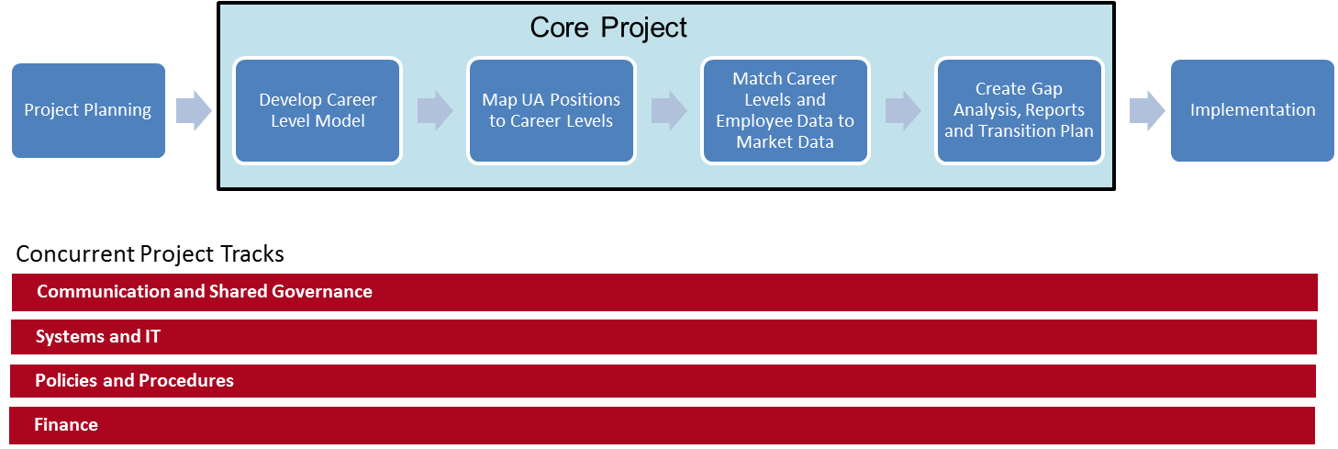
UCAP PHASES (Estimated two year timeline)
Notes:
Kelly

Slide 15
WHAT QUESTIONS DO YOU HAVE ABOUT THIS PROJECT?
WHAT CONCERNS DO YOU HAVE ABOUT THIS PROJECT?
WHAT ELEMENTS OF OUR CURRENT JOB AND COMPENSATION PROGRAMS ARE IMPORTANT TO KEEP?
WHAT ELEMENTS WOULD YOU LIKE TO CHANGE?

