Slide 1
College Environment Committee
MEZCOPH College Retreat
May 15, 2017

Slide 2
College Environment Committee
Presentation Agenda:
Introduction of the CEC and Teams: Michael
Physical Space Team: Ryley
Life/Work Balance Team: Kim
New Hire Tool Kit: Kim
Mission/Vision/Values/Civility: Spencer and Michael
Wrap up, distribution of volunteer lists: Michael
The Mel and Enid Zuckerman College of Public Health is dedicated to promoting the health of individuals and communities in the southwest and globally with an emphasis on achieving health equity through excellence in education, research & service.

Slide 3
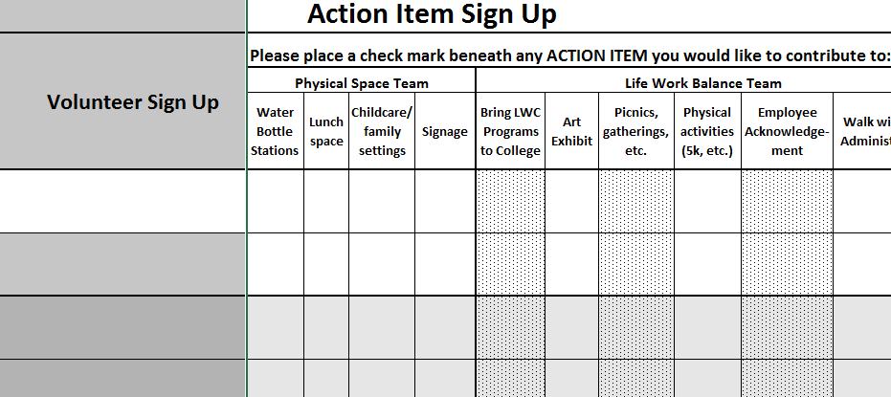
College Environment Committee
Get involved!
The Mel and Enid Zuckerman College of Public Health is dedicated to promoting the health of individuals and communities in the southwest and globally with an emphasis on achieving health equity through excellence in education, research & service.

Slide 4
College Environment Committee
Tracking our success:
The Mel and Enid Zuckerman College of Public Health is dedicated to promoting the health of individuals and communities in the southwest and globally with an emphasis on achieving health equity through excellence in education, research & service.

Slide 5
College Environment Committee
Physical Space Team:
Key Accomplishments:
Lactation Room
Space has been identified in 3rd floor mail room.
Applied for CSW grant to build and furnish room.
Bike Valet
Working with Parking and Transportation to secure a bike valet for AHSC.
Gender Neutral Bathroom
Facilities Management is working on this initiative campus-wide.
The Mel and Enid Zuckerman College of Public Health is dedicated to promoting the health of individuals and communities in the southwest and globally with an emphasis on achieving health equity through excellence in education, research & service.

Slide 6
College Environment Committee
Physical Space Team:
Resources/volunteers needed for:
Starting on new projects
Previously identified: refillable water bottle stations, lunch space, childcare/family friendly settings, better signage and maps for first and second floor of Drachman.
Lactation Room Support
When funding has been secured, help in furnishing room would be appreciated!
New ideas/requests?
The Mel and Enid Zuckerman College of Public Health is dedicated to promoting the health of individuals and communities in the southwest and globally with an emphasis on achieving health equity through excellence in education, research & service.

Slide 7
College Environment Committee
Life/Work Balance Team:
Key Accomplishments:
Work with Life Work Connections to bring existing programs to the college
Photo/art projects in public spaces to encourage conversation and community
The Mel and Enid Zuckerman College of Public Health is dedicated to promoting the health of individuals and communities in the southwest and globally with an emphasis on achieving health equity through excellence in education, research & service.

Slide 8
College Environment Committee
Life/Work Balance Team:
Resources/volunteers needed for:
Work with Life Work Connections to bring existing programs to the college
Photo/art projects in public spaces to encourage conversation and community
Social events (picnics, gatherings after work, etc.)
Physical activities (e.g. 5K fun run)
Employee recognition (awards, announcements via the Hub, college retreat, newsletters, etc.)
"Walk with the Dean/Administrator" (monthly)
The Mel and Enid Zuckerman College of Public Health is dedicated to promoting the health of individuals and communities in the southwest and globally with an emphasis on achieving health equity through excellence in education, research & service.

Slide 9
College Environment Committee
New Hire Tool Kit Team:
Key Accomplishments:
Resource Guide for new employees developed – will be on the Hub soon.
New Hire Toolkit developed along with New Hire Protocol for onboarding new employees
Preparing to test processes with a new hire this May!
The Mel and Enid Zuckerman College of Public Health is dedicated to promoting the health of individuals and communities in the southwest and globally with an emphasis on achieving health equity through excellence in education, research & service.

Slide 10
College Environment Committee
New Hire Tool Kit Team:
Resources/volunteers needed for:
Reviewers for Resource Guide
Possible testers for the New Hire Protocol
Identify departmental representatives
New committee members
The Mel and Enid Zuckerman College of Public Health is dedicated to promoting the health of individuals and communities in the southwest and globally with an emphasis on achieving health equity through excellence in education, research & service.

Slide 11
College Environment Committee
MVVC Team:
Key Accomplishments:
Improve visibility of the College’s mission, vision, and values (virtually and physically)
Conflict resolution resources.
Compile list of educational resources to increase cultural humility and civility
Inclusion of the m/v/v and civility in new student orientations
The Mel and Enid Zuckerman College of Public Health is dedicated to promoting the health of individuals and communities in the southwest and globally with an emphasis on achieving health equity through excellence in education, research & service.

Slide 12
College Environment Committee
MVVC Team:
Resources/volunteers needed for:
Inclusion of the m/v/v in hiring practices and documents
Inclusion of the m/v/v in new-hire orientations
Inclusion of the m/v/v in strategic planning of college/departments (Inclusive Excellence Committee)
Fall distribution of the Mission
The Mel and Enid Zuckerman College of Public Health is dedicated to promoting the health of individuals and communities in the southwest and globally with an emphasis on achieving health equity through excellence in education, research & service.

Slide 13
College Environment Committee
Get involved!
The Mel and Enid Zuckerman College of Public Health is dedicated to promoting the health of individuals and communities in the southwest and globally with an emphasis on achieving health equity through excellence in education, research & service.

