Slide 1
Epidemiology & Biostatistics
Travel Policies and Procedures
Updated 3/13/2019

Slide 2
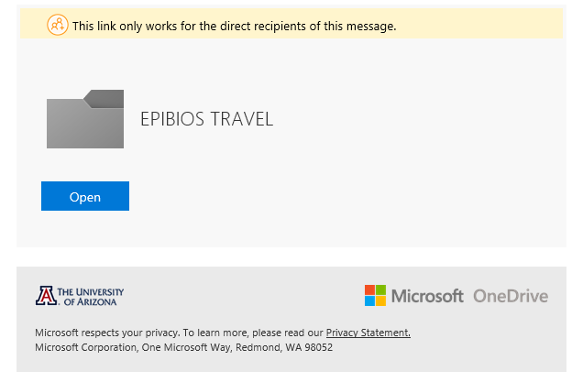
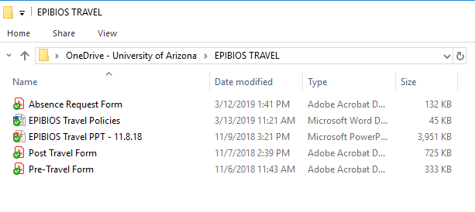
You can access the EPI/BIOS travel forms on One Drive:
You will receive an email with the link to the One Drive EPIBIOS TRAVEL folder

Slide 3
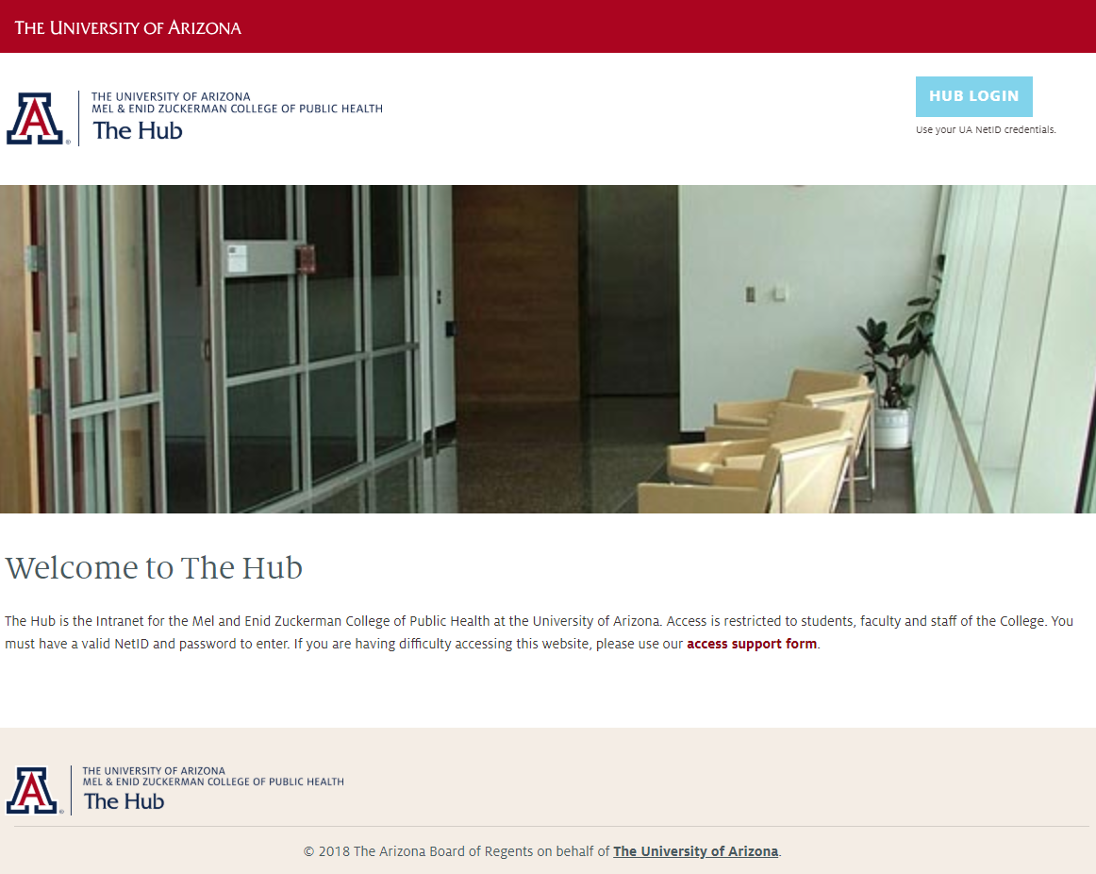
Travel forms are also available on the COPH hub:
https://hub.coph.arizona.edu/

Slide 4
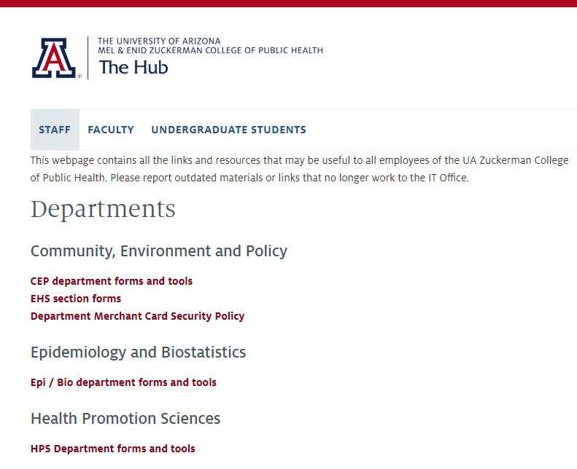
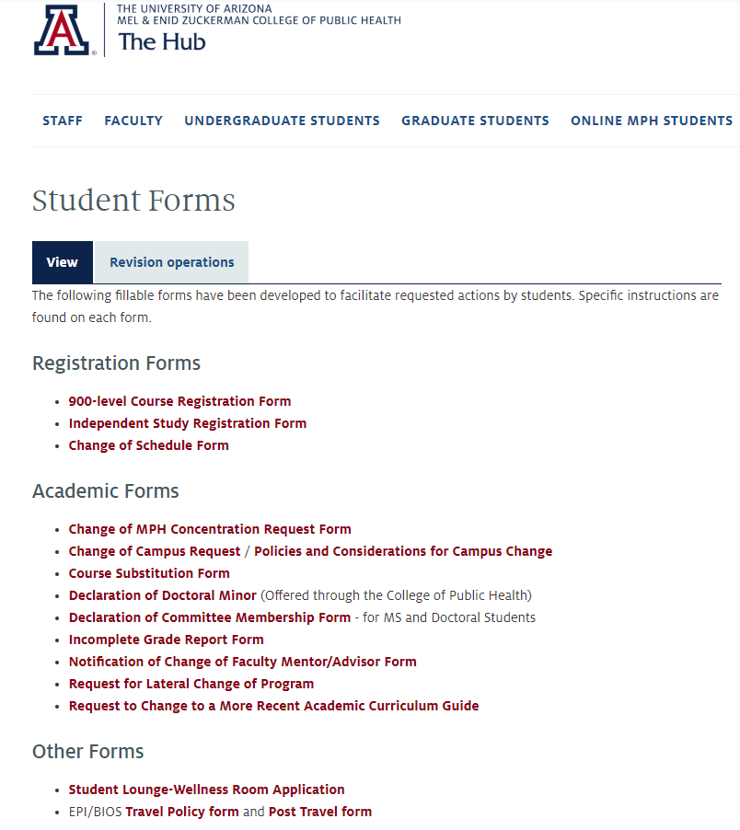

Slide 5
Changes to note:
• Travel Authorization Form is now an electronic document
Domestic Travel
International Travel
Please submit your travel, with supporting documentation, at least 2 weeks prior to departure date
Please submit your travel, including international registry #, with supporting documentation at least 4 weeks prior to departure date
Email revised travel dates or cancellations to the
Travel Admin or Amy Maniscalco

Slide 6
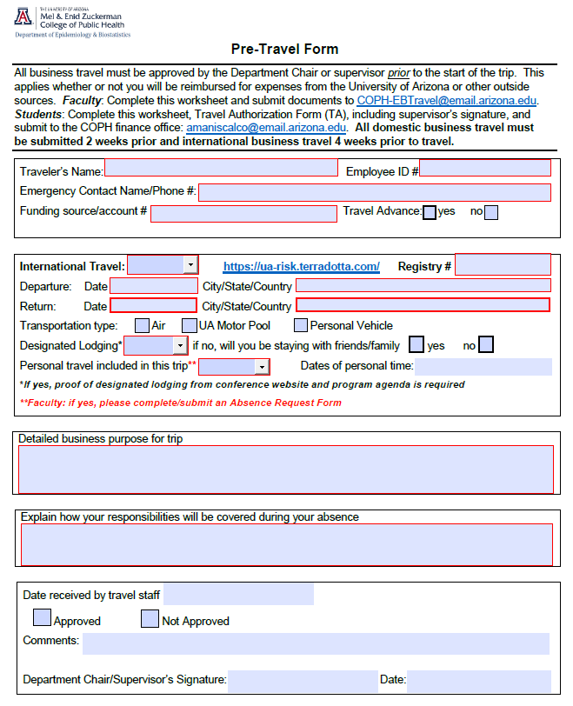
Faculty: send completed form to: COPH-EBTravel@email.arizona.edu
Staff/Students: send completed/signed pre-travel form and travel authorization to: amaniscalco@email.arizona.edu or sharonb@email.arizona.edu
Travel Authorization link:
https://eforms.fso.arizona.edu/createPdf/5/

Slide 7
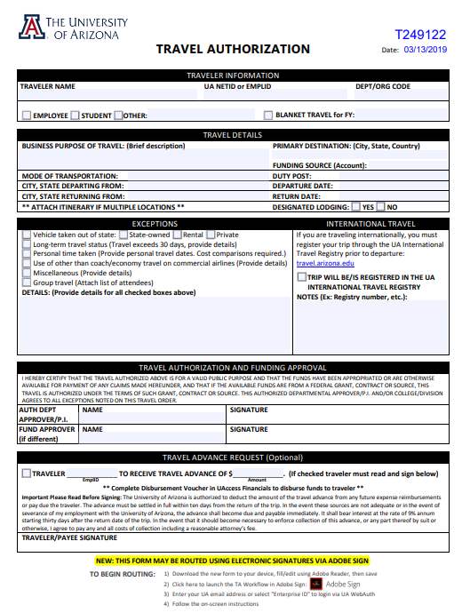
Please complete the top 3 sections of the Travel Authorization Form
Please email completed TA to: sharonb@email.arizona.edu, who will submit through Adobe Sign for approval

Slide 8
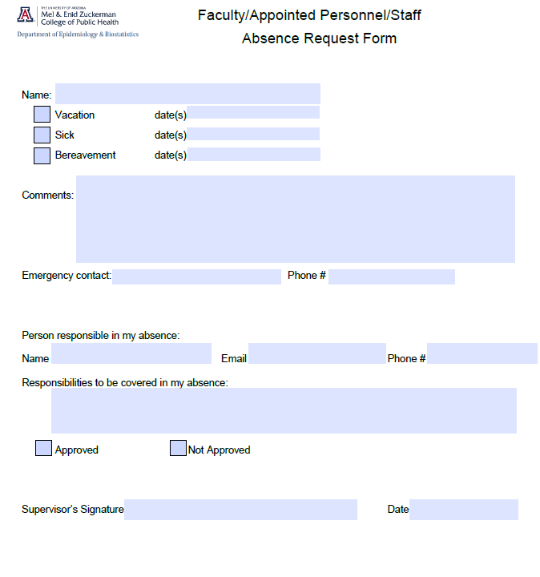

Slide 9
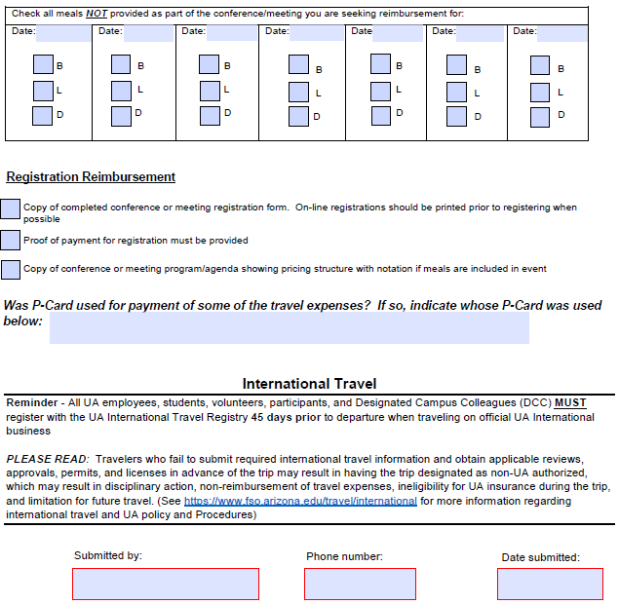
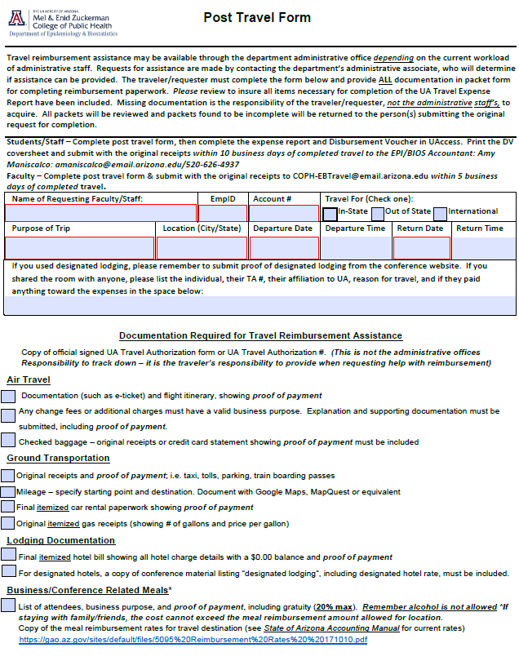
Faculty: please submit completed form with original receipts to Travel Admin within 5 business days of completed travel.
Staff/Students: please submit completed post-travel form w/original receipts, expense report (TER) and DV to Amy Maniscalco or Travel Admin within 10 business days
(step-by-step presented in slides below)

Slide 10
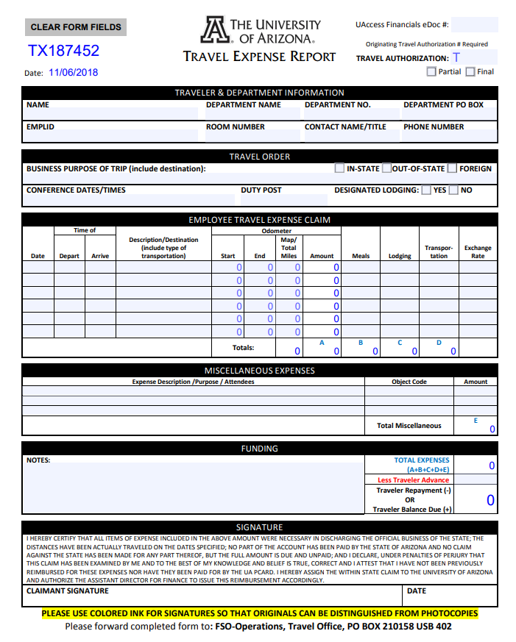
https://eforms.fso.arizona.edu/createPdf/6/

Slide 11
Staff / Students
How to Enter a
DV(Disbursement Voucher) in UAccess

Slide 12
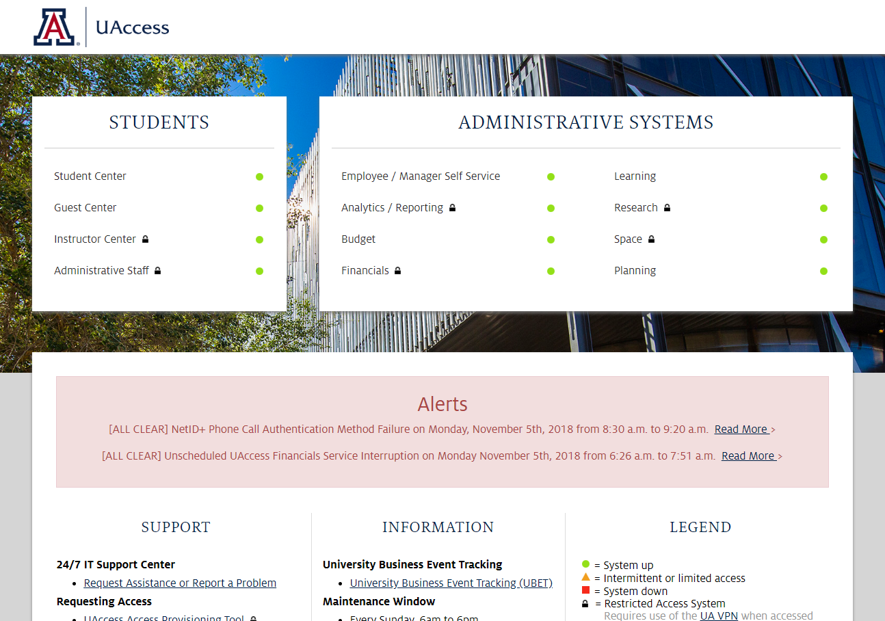
UAccess Title Page
https://uaccess.arizona.edu/
Go to UAccess title page
Under Administrative Systems – click Financials

Slide 13
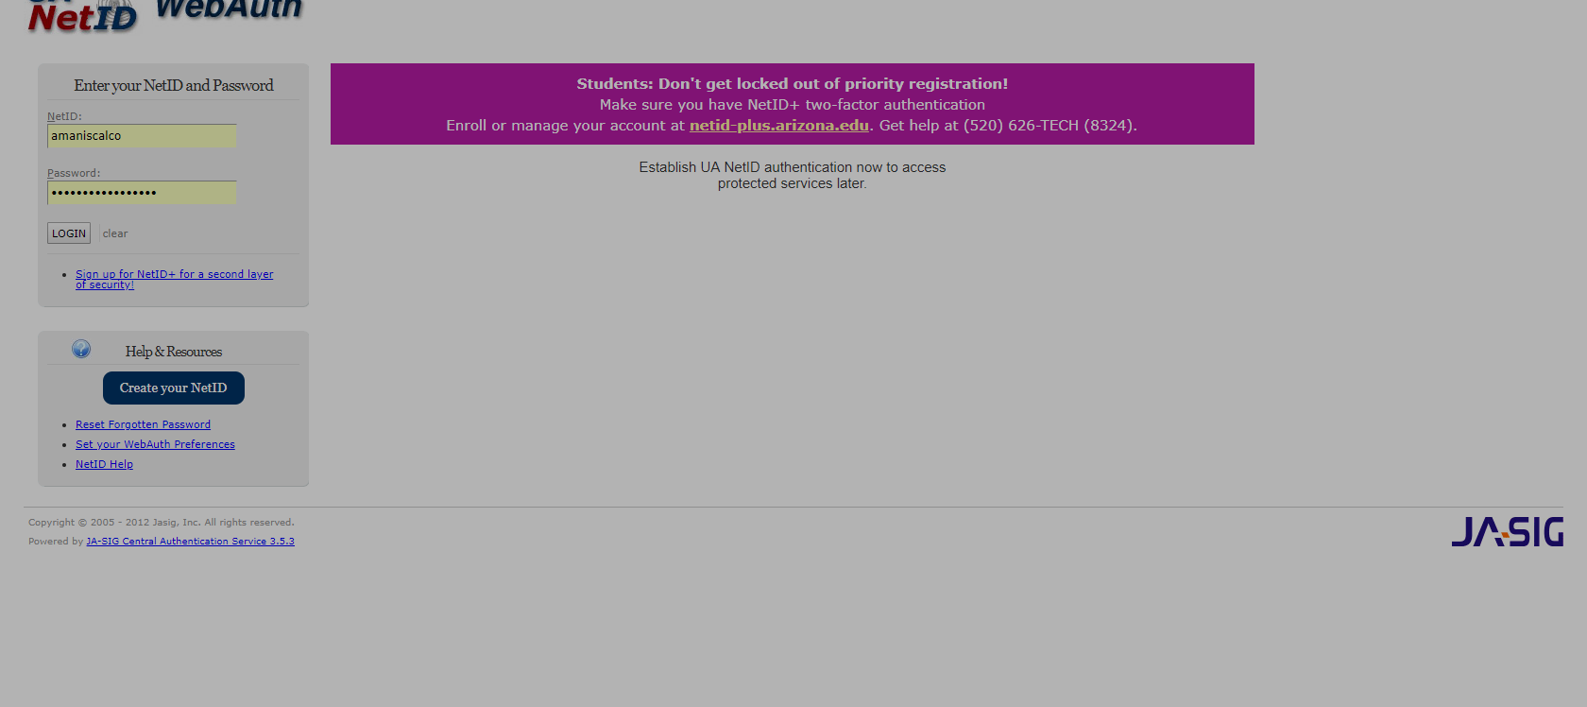
1.) Sign in with your NetID and Password -- Enter
2.) Duo Push -- Enter

Slide 14
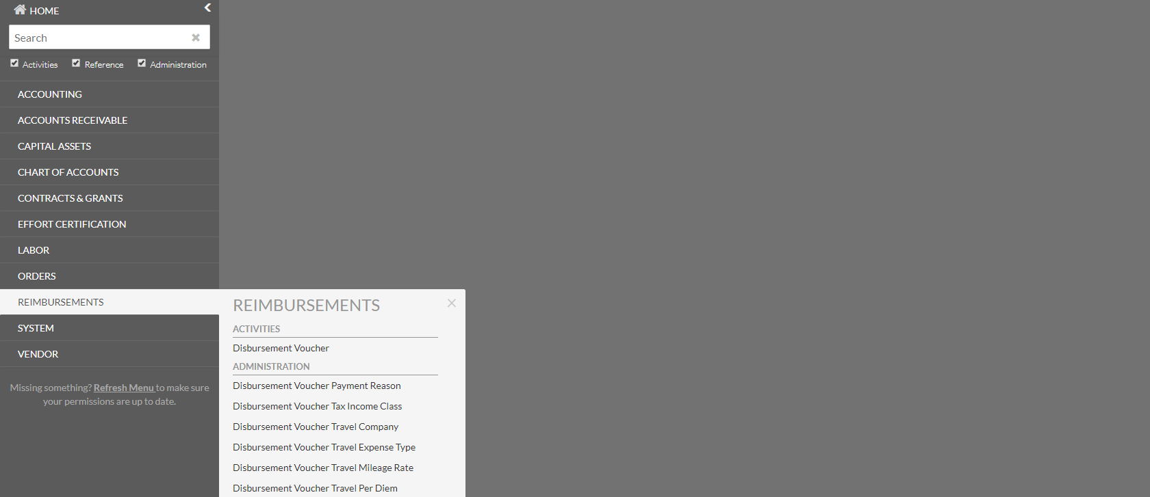
Financials: Home Screen
1.) Click on Reimbursements
2.) Select Disbursement Voucher -- Enter

Slide 15
Document Overview
1.) Description : Input Name and Location
2.) Explanation: “Travel Reimbursement” – “Name” “location” “business purchase of travel” “dates”
3.) Organization Document Number: “Travel Authorization Number”

Slide 16
PAYMENT INFORMATION
1.) Payee ID: Click hourglass

Slide 17
1.) Payment Reason Code: Click down arrow and select “Travel Expense”
2.) Traveler’s First Name: “ *first name* “
3.) Traveler’s Last Name: “ *last name* “
4.) Search
5.) List of names will appear
6.) “Return Value” of correct Person

Slide 18
PAYMENT INFORMATION
1.) Name and address of Traveler will populate
2.) Check Amount: Enter full amount
3.) Check Stub Text: Brief Description

Slide 19
ACCOUNTING LINES
1.) Chart: Down arrow – choose “UA”
2.) Account: Account number
3.) Object: Object Code
  6140 – Instate Travel
  6240 – Out of State Travel
  6340 – Foreign Travel
4.) Amount: Full amount of reimbursement
5.) Line Description: Brief Description
6.) Invoice Number: “TA# - EXP – End date of Trip”
7.) Actions: “+”

Slide 20
1.) TRAVELERS INFORMATION: Name – Business Purpose – Destination – Organization Name
2.) Destination:
From: City – State – Country – Date and Time (left from Tucson)
To: City – State – Country – Date and Time (returned to Tucson)
3.) Travelers Expenses
Type: Arrow down – “OTHER”
Company: “OTHER”
Amount: Full Amount of Reimbursement
4.) “Add” - Enter

Slide 21
NOTES AND ATTACHMENTS
Enter all pertinent information
Examples:
Personal days taken and that traveler is not claiming lodging, meal reimbursement, etc.
Shared Lodging with (Name of person(s) and their travel authorization #s
Bottom of Screen
1.) Save your document again
2.) Submit

Slide 22
If you have completed the form successful on the top of the document you should have a request to “Print Disbursement Voucher Coversheet.”
1.) Print .pdf
2.) Attach to Travel Expense Report and Original Receipts
If you have an error please email: amaniscalco@email.arizona.edu

Slide 23
Packet should include the following:
1.) DV Coversheet
2.) Travel Expense Report Completed and signed by the traveler (see fillable .pdf on University of Arizona-Travel website: https://www.fso.arizona.edu/travel
3.) Conference Brochure and Agenda ; Meeting Agenda
If you stayed @ a designated lodging the conference brochure must have the lodging listed and the rates
4.) Flight information (if traveled by air) with Traveler's Name; Itinerary; last four digits of credit card paid with and amount paid
5.) If drove to destination; google map showing to/from destination with total miles.
(Mileage Rate: $0.445/per mile)
5.) Hotel Folio (if stayed in hotel); Name of travel; detail of amount charged EACH day; total; last four digits of credit card paid with and balance $0.
6.) Any and all additional receipts (parking, uber, etc.).
7.) All receipts should be 8x11 piece of paper, IF NOT, tape on all sides to 8x11 piece of white copy paper.
DO NOT TAPE OVER AMOUNTS OR DETAIL OF RECEIPT.
If you have any questions, do not hesitate to contact EPI/BIOS
Administrative Associate (sharonb@email.arizona.edu) or Accountant (amaniscalco@email.arizona.edu).

Slide 24

Thank you!

